Slide 1
Unit 2: Computer Systems Hardware

Slide 2
Bus
A bus is a subsystem that transfers data between components inside a computer, or between computers.

Slide 3
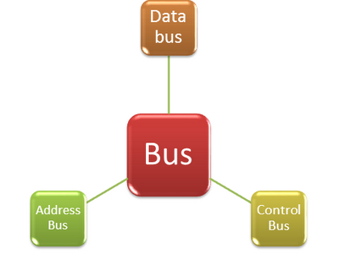
Types of Bus
1. Address buses: these buses carry address given by the CPU from one unit to another in the computer. 2. Data buses: These buses carry data from one unit to other, it is a bi-directional bus i.e the data can be carried in both directions. 3. Control signal: These buses carry control signal from ALU to memory and from memory to ALU and then to the output unit.

Slide 4
Auxiliary Storage
Auxiliary memory units are among computer peripheral equipment.
They trade slower access rates for greater storage capacity and data stability. Auxiliary memory holds programs and data for future use.
Examples of auxiliary storage media are magnetic diskettes, optical disks including CD ROM, and magnetic tape cassettes.

Slide 5
Motherboard
The main circuit board of a microcomputer.
The motherboard contains the connectors for attaching additional boards. Typically, the motherboard contains the CPU, BIOS, memory, mass storage interfaces, serial and parallel ports, expansion slots, and all the controllers required to control standard peripheral devices, such as the display screen, keyboard, and disk drive. Collectively, all these chips that reside on the motherboard are known as the motherboard's chipset.
On most PCs, it is possible to add memory chips directly to the motherboard. You may also be able to upgrade to a faster PC by replacing the CPU chip. To add additional core features, you may need to replace the motherboard entirely.

Slide 6
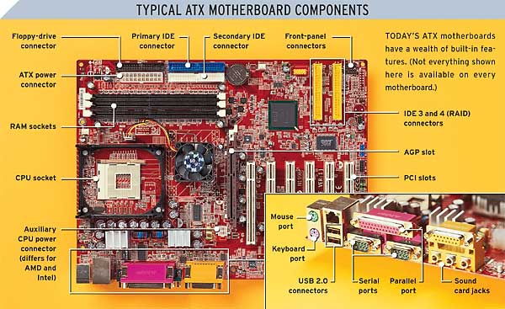
Motherboard

Slide 7
Power supply
The power supply converts the alternating current (AC) line from your home to the direct current (DC) needed by the personal computer.
In a personal computer (PC), the power supply is the metal box usually found in a corner of the case. The power supply is visible from the back of many systems because it contains the power-cord receptacle and the cooling fan.
Power supplies, often referred to as "switching power supplies", use switcher technology to convert the AC input to lower DC voltages.

Slide 8
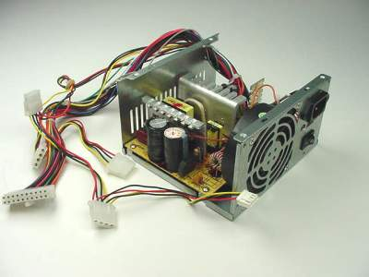
Power supply

Slide 9
Cooling Unit
The phrase cooling in computing generally refers to the dissipation of large amounts of heat, which is created while a computer system is running.
Heat is generated inside the computer tower by various hardware such as CPU, video card or even the hard drive.
The objective of cooling is to maintain an optimal operating temperature and this can be achieved through various methods including the introduction of heat sinks and fans. Other cooling methods include liquid cooling and software cooling.

Slide 10
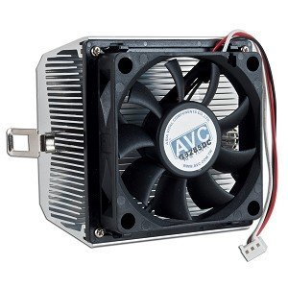
Cooling Unit

Slide 11
Hard disk drive
A hard disk drive (HDD) is a data storage device used for storing and retrieving digital information using rapidly rotating discs (platters) coated with magnetic material.
An HDD retains its data even when powered off. Data is read in a random-access manner, meaning individual blocks of data can be stored or retrieved in any order rather than just sequentially. An HDD consists of one or more rigid ("hard") rapidly rotating discs (platters) with magnetic heads arranged on a moving actuator arm to read and write data to the surfaces.

Slide 12
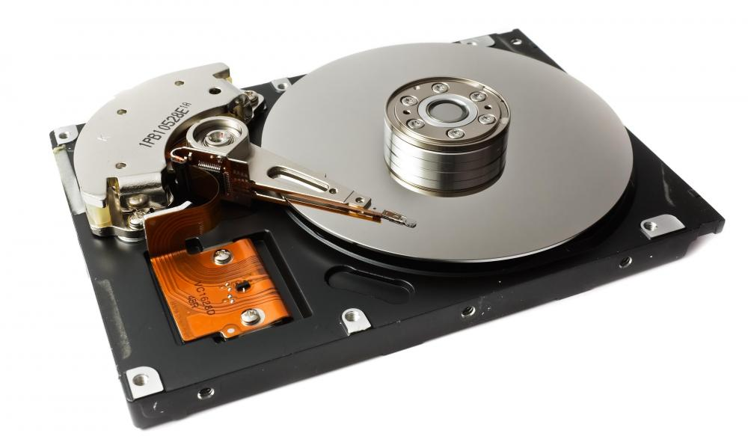
Hard disk drive

Slide 13
Port
An interface on a computer to which you can connect a device.
Personal computers have various types of ports. Internally, there are several ports for connecting disk drives, display screens, and keyboards. Externally, personal computers have ports for connecting modems, printers, mice, and other peripheral devices.
Almost all personal computers come with a serial RS-232C port or RS-422 port for connecting a modem or mouse and a parallel port for connecting a printer. On PCs, the parallel port is a Centronics interface that uses a 25-pin connector. SCSI (Small Computer System Interface) ports support higher transmission speeds than do conventional ports and enable you to attach up to seven devices to the same port.
To move a program from one type of computer to another. To port an application, you need to rewrite sections that are machine dependent, and then recompile the program on the new computer. Programs that can be ported easily are said to be portable.

Slide 14
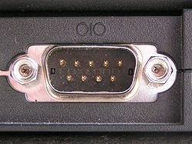
Serial port
A port, or interface, that can be used for serial communication, in which only 1 bit is transmitted at a time.
A serial port is a general-purpose interface that can be used for almost any type of device, including modem, mouse, etc.

Slide 15
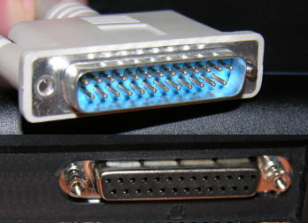
parallel port
A parallel interface for connecting an external device such as a printer. Most personal computers have both a parallel port and at least one serial port.

Slide 16
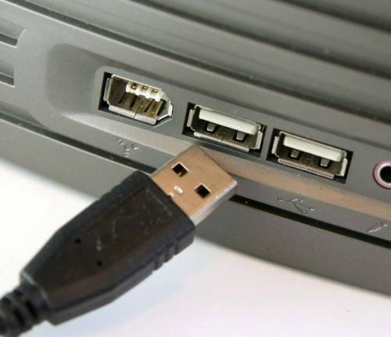
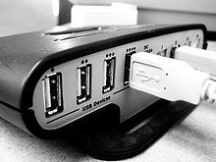
USB Port
Short for Universal Serial Bus, an external bus standard that supports data transfer rates of 12 Mbps. A single USB port can be used to connect up to 127 peripheral devices, such as mice, modems, and keyboards. USB also supports Plug-and-Play installation.

Slide 17
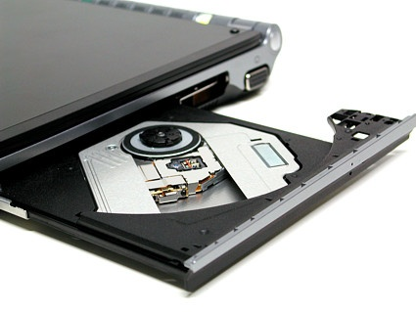
Optical Driver
A machine that reads data from and writes data onto a disk. A disk drive rotates the disk very fast and has one or more heads that read and write data.

Slide 18
Peripheral component interconnect(PCI)
A local bus standard developed by Intel Corporation
PCI defines the electrical characteristics and signal protocol used for two devices to communiate over a computer's central bus.
How does it work?
The processor is connected to the other components like the hard drives, the main memory and the PCI slots by the use of a front-side bus. The speed of the front side bus can reach up to 400 Mhz with a system operating at the speed of 800 Mhz. The backside bus usually has a quicker speed than the front-side bus but operates at the same rate as the processor itself. Though it is a detached connection, it ensures the connection between the processor and the Level 2 cache. With time, the level 2 cache was included in the main processor to make them more affordable and easier to use.

Slide 19
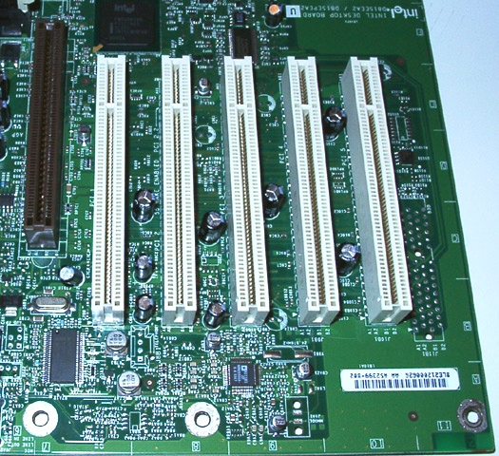

Slide 20

Accelerated Graphics Port(AGP)
AGP is an advanced port designed for Video cards and 3D accelerators.

Slide 21
network interface card(NIC)
A network interface card (NIC) is a computer circuit board or card that is installed in a computer so that it can be connected to a network.
Personal computers and workstations on a local area network (LAN) typically contain a network interface card specifically designed for the LAN transmission technology, such as Ethernet or token ring.
Network interface cards provide a dedicated, full-time connection to a network.
Most home and portable computers connect to the Internet through as-needed dial-up connection. The modem provides the connection interface to the Internet service provider.

Slide 22
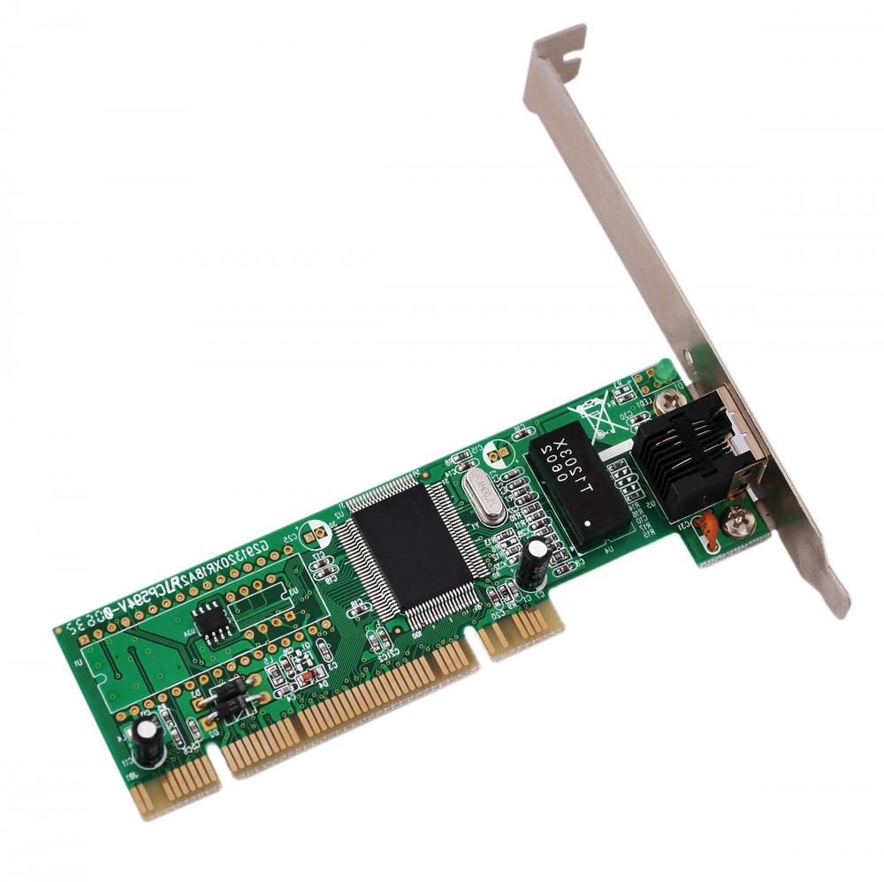

Slide 23
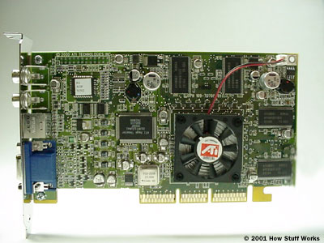
Graphics card
Graphics cards take data from the CPU and turn it into pictures.

Slide 24
modem
A modem is a device or program that enables a computer to transmit data over, for example, telephone or cable lines.
Computer information is stored digitally, whereas information transmitted over telephone lines is transmitted in the form of analog waves. A modem converts between these two forms.

Slide 25
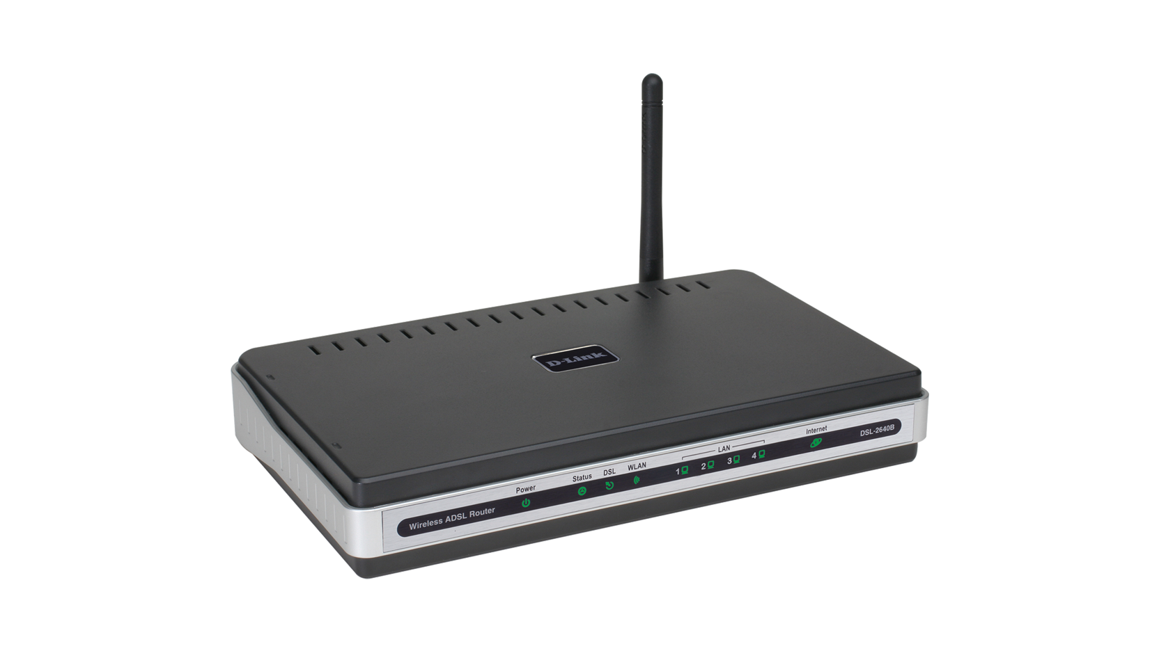

Slide 26
Sound card
An expansion board that enables a computer to manipulate and output sounds.
Sound cards enable the computer to output sound through speakers connected to the board, to record sound input from a microphone connected to the computer, and manipulate sound stored on a disk.

Slide 27
